Slide 1
“Running Household Chores with Samuel.”
CS-517
Team Boom!
Team Members
Redwan Ul Haq Choyon
Indronil Bhattacharjee
Sarhan Osman Bhuiya
Mingfang Zhu
Christopher Biekeu
Digital Game Design

Slide 2
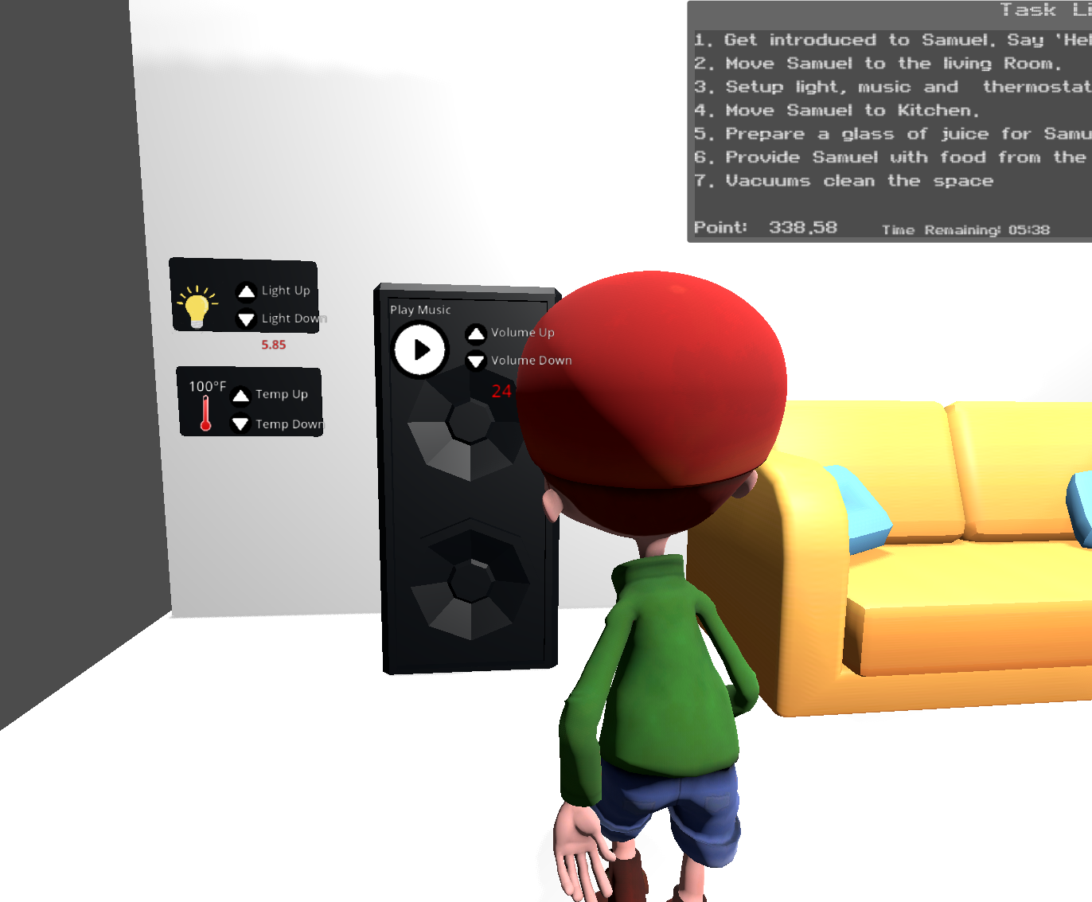
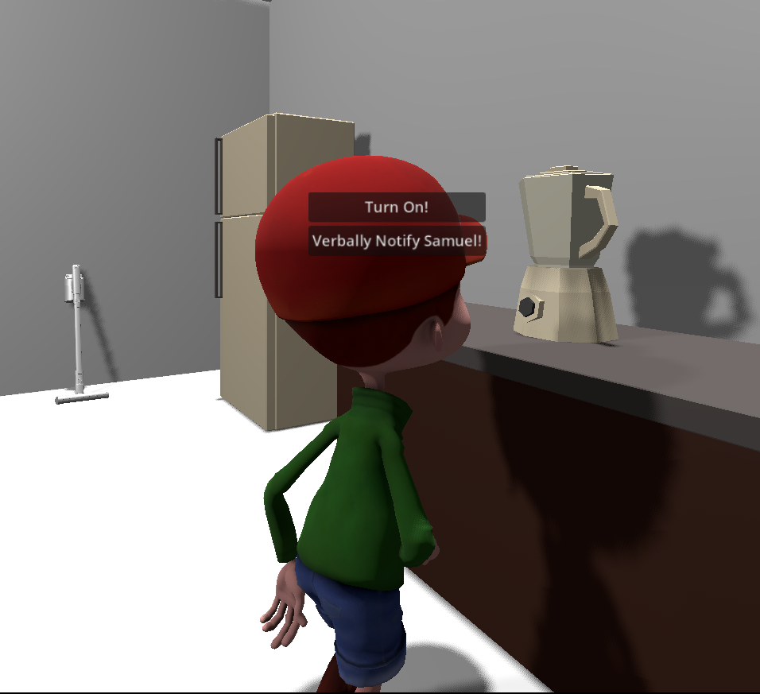
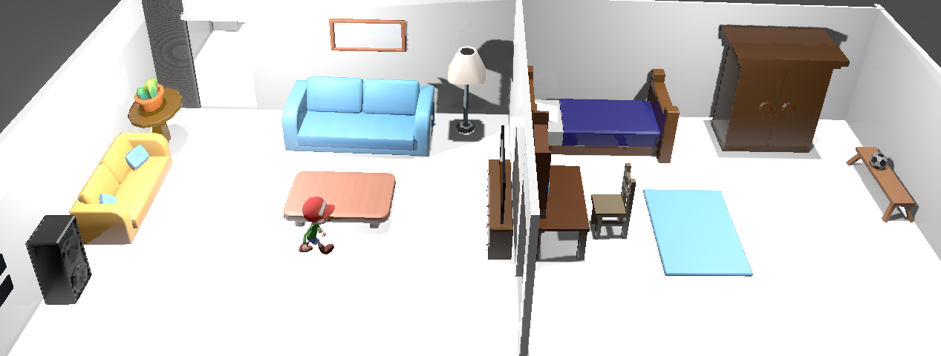
Game Description
Vision
A 3D game designed to foster empathy and awareness about sensory differences and neurodiversity.
Objective
Complete household chores alongside Samuel.
Communicate and perform tasks in ways suitable for Samuel.
Earn bonus points for completing tasks before the time limit.
Experience sensory differences and neurodivergent communication preferences through gameplay.
Platform
Developed in Godot for Desktop and Virtual Reality.
Audience
Neurotypicals aged 7–21 interested in learning about neurodiversity.

Slide 3
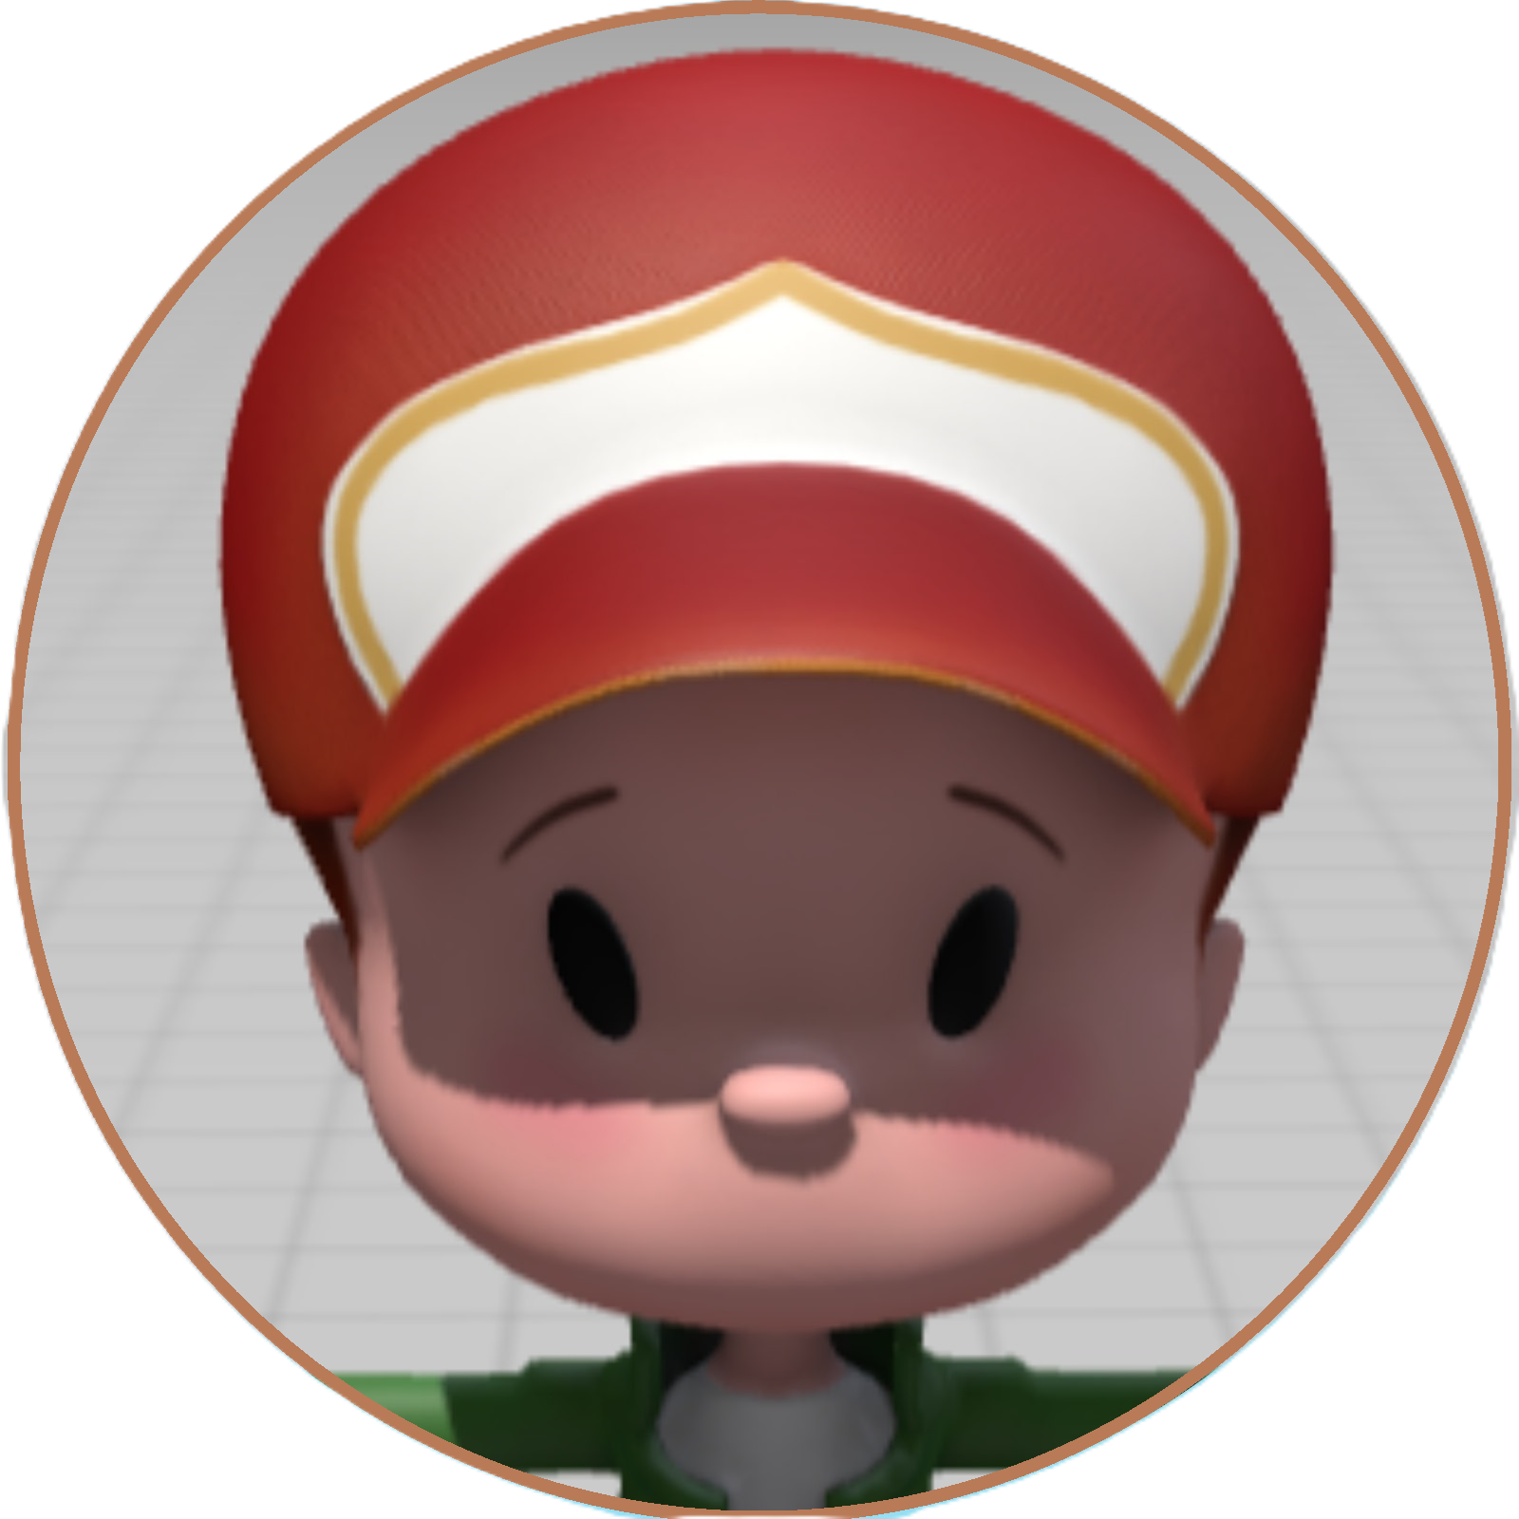

Game Mechanics
Game Characters
Samuel:
A neurodivergent child,
Sensitive to environmental changes and interactions.
Focal point of the game, his reactions depend on how tasks are performed.
Player:
The caregiver
Playing from a first-person perspective (FPOV)
Responsible for completing tasks
Ensure that Samuel remains calm.
Core Gameplay
7 household tasks:
Greet Samuel: Say "Hello Samuel."
Move Samuel to the living room.
Adjust light, music, and thermostat for sensory comfort.
Guide Samuel to the kitchen.
Prepare a glass of juice for Samuel.
Provide Samuel food from the fridge.
Vacuum clean the space.

Slide 4
Gameplay Mechanics
Scoring Policy
+200 points: Samuel completes a task following instructions.
-10 points: Samuel gets agitated (e.g., runs away).
-20 points: Samuel gets upset and starts crying.
Finishing all tasks completes the level.
Time Bonus/Penalty:
-1 point: For every 5 seconds of delay.
+10 points: For every 5 seconds saved before the given time.
Players experience Samuel’s sensory perception, showcasing how he processed communication and environment changes as end game feedback.
Game Iterations
Iteration 1: A 3D version developed in Godot.
Iteration 2: Enhanced 3D version based on Playtest feedback
Iteration 3: Tried to port in Oculus Quest, but OpenXR did not work.

Slide 5
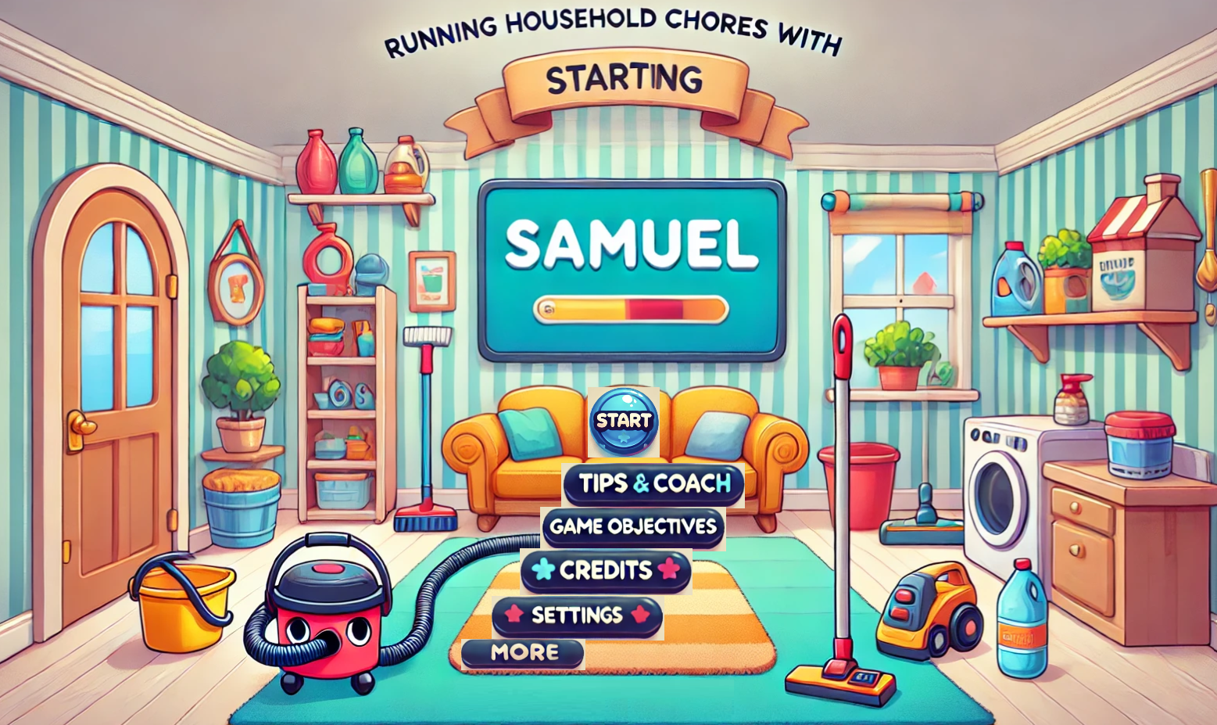
Demo Introduction

Slide 6
Milestones and Iterations
Key Iterations
Iteration 1 - 3D Version:
keyboard control for task completion
Simple interactions in such as point-and-click for tasks.
Iteration 2 - Play Test Enhancement
Changed UI (Coach addition) based on feedback
Changed scoring policy based on feedback
Added objective and more information in the game based on feedback.
Iteration 3 - VR Porting
Failed gracefully as Open XR did not work.
Team worked continuously. Tested 4 different computers, 2 Quest Devices, 2 OSs and 3 versions of Godot.
Requested for help in the forum, tried to communicate OpenXR Plugin developer.
Development Timeline
Phase 1: Concept and Planning
Completed initial concept and story outline;
Defined core gameplay mechanics and scoring system.
Phase 2: Development, Testing and Feedback
Iteration 1 - Built a functional 3D version.
Iteration 2 - Incorporated feedback on playtest.
Phase 3: VR Porting
Attempted VR compatibility but facing technical difficulties.
Conducted playtesting sessions with participants from the target audience (ages 7–21).

Slide 7
Post-Mortem Analysis
What Worked
Effective representation of neurodivergent experiences
Created empathy in players
Scoring system motivated players to complete tasks efficiently and thoughtfully.
Received positive feedback regarding awareness of sensory differences.
Challenges
VR Integration Issues:
Technical difficulties in adapting gameplay mechanics for VR
Ensuring smooth interactions of Godot with VR
Lessons Learned
Direct engagement with target audiences through surveys
Surveys provided actionable feedback that significantly improved the game
Importance of iterative design based on real-world user experiences.

Slide 8
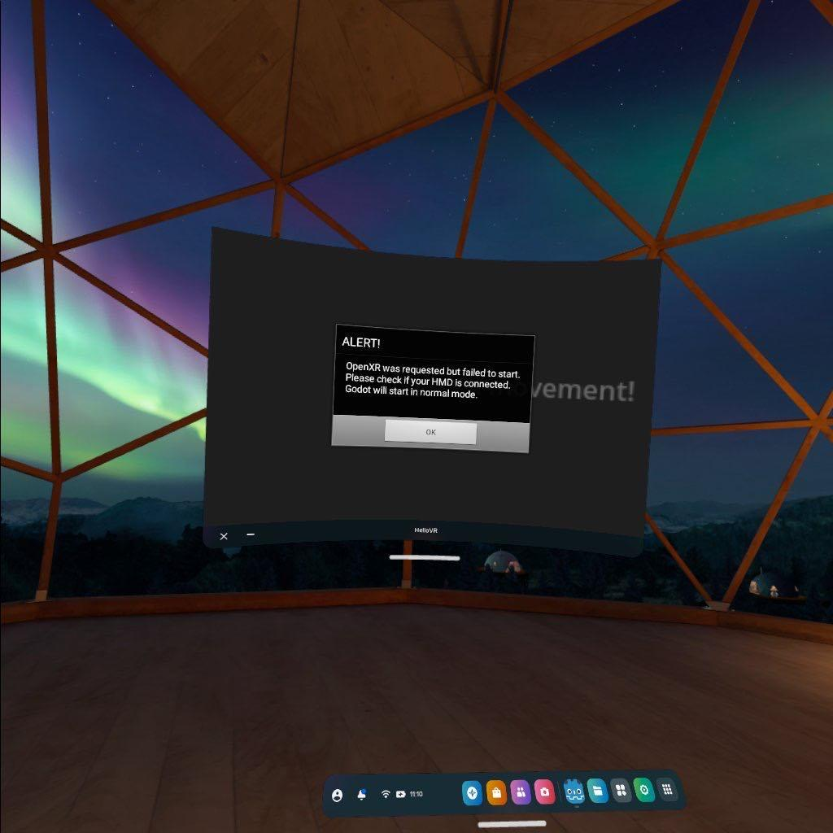
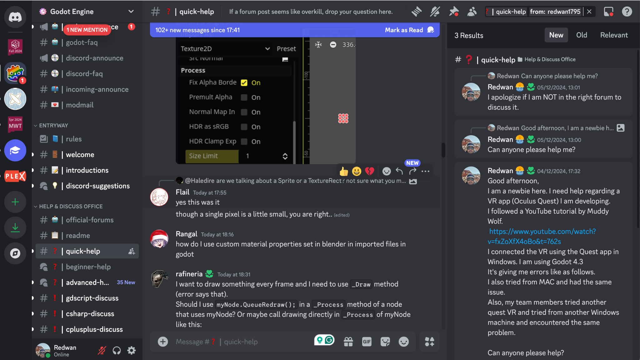
What Happened in VR Porting?

Slide 9
Conclusion
Game’s Impact
Raised awareness of neurodiversity and sensory differences in neurotypical players;
Helped foster empathy and understanding through interactive and immersive experiences.
Future Directions
Expanding the game to include more tasks and diverse neurodivergent experiences.
Focusing on completing VR implementation to create a fully immersive experience. We might shift to Unity for VR porting.
Possibly Playtest with LCPS special Ed teachers
"Running Household Chores with Samuel" is more than a game—it's a tool for education and empathy. Our team's efforts highlight the potential of games in addressing social and psychological themes.

Slide 10
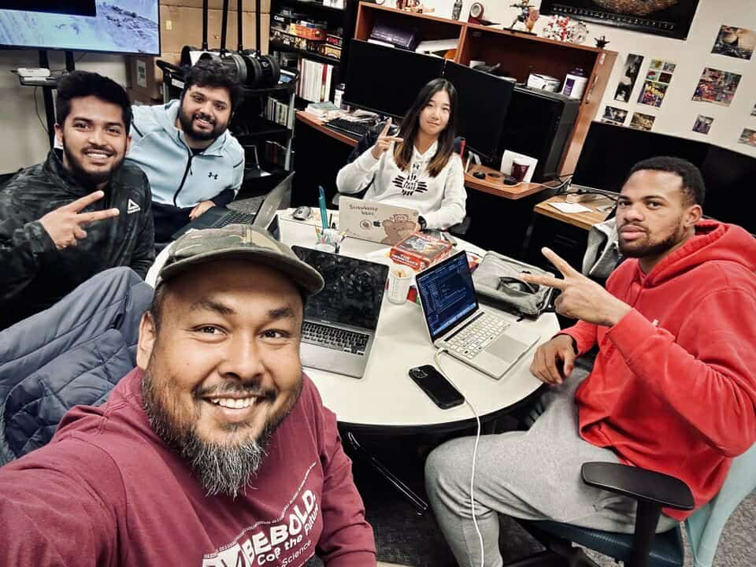
Thank You!
Any Questions?
Digital Game Design
CS-517

